Slide 1
Advanced spreadsheets
Lesson 1: Drop-down lists, VLOOKUP and sorting data

Slide 2
Objectives
In this lesson, you will learn how to:
create drop-down lists to validate data entry
use the VLOOKUP function to find data in a table and return related information
sort data in a spreadsheet.

Slide 3
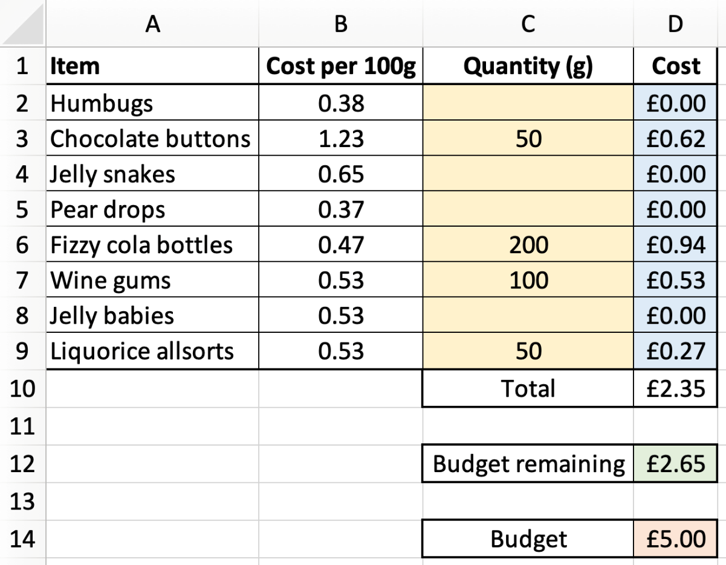
A spreadsheet

Slide 4
Customising spreadsheets
You should already be familiar with a range of features in spreadsheets, including:
simple formulae
relative and absolute cell references
functions such as SUM, AVERAGE and IF
conditional formatting.
We are now going to look at extra features to help us customise spreadsheets and make them more versatile and user-friendly.

Slide 5
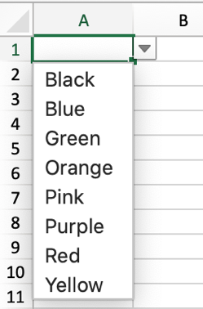
Drop-down lists
A drop-down list is a type of validation.
It limits the values that can be entered into a cell. This helps keep the data in the spreadsheet consistent and accurate, reducing errors and making the spreadsheet more useful.

Slide 6
Creating drop-down lists
Type the words you want to use in your drop-down list into a column. It is best practice to type the words alphabetically.
Use an area of the spreadsheet that will not normally be seen, but which can still be accessed easily.
Click on the cell in which you want the drop-down list to appear. Then select ‘Data’ and ‘Data Validation’, choose Allow ‘List’ and select the cells containing the data you want to appear in the drop-down list.
Now watch Video 1.1

Slide 7

Activity 1.1: Stationery shop (part 1)

Slide 8
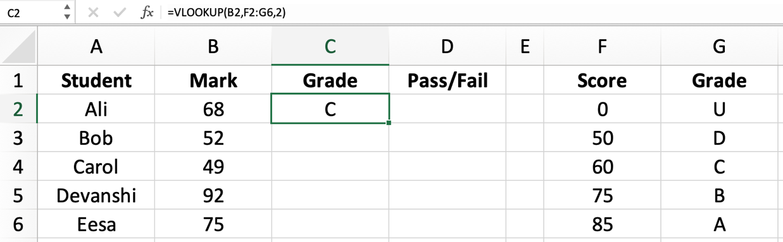
The VLOOKUP function
The VLOOKUP function takes the value in a cell, searches for it in a table of data elsewhere on the spreadsheet and returns the value in an adjacent cell.
In this example, the VLOOKUP function is comparing Ali’s mark in cell B2 to the scores in column F to find out his grade. A score of 68 is a grade C and so C is returned to cell C2.

Slide 9
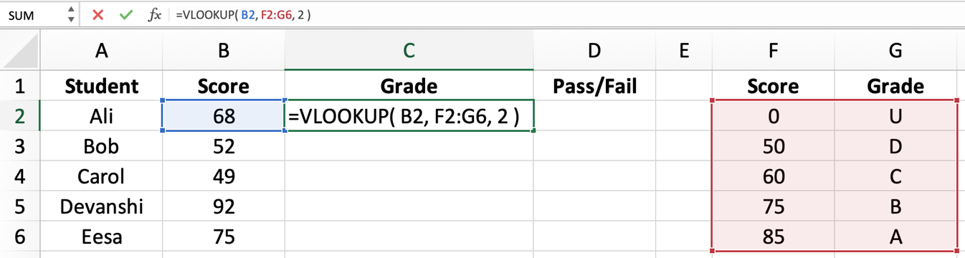
Using the VLOOKUP function
The VLOOKUP function has the following structure:
=VLOOKUP( lookup value, range, column number )
Now watch Video 1.2
[Insert 07_04]
The lookup value that you wish to search for
The column number of the range that contains the value to be returned
The range of cells containing the lookup value
These should be absolute cell references if the function is going to be replicated

Slide 10
Activity 1.1: Stationery shop (part 2)

Slide 11
Activity 1.2: Exam grades

Slide 12
Sorting data
As you know, the data in the first column of the table used in a VLOOKUP needs to be in alphabetical (A–Z) or numerical (0–100) order.
It is easy to sort the data into order using the sort facility.
It is possible to sort the whole worksheet, or just a selected range of cells.
You select the range of cells that you need to sort, then choose ‘Sort’ from the ‘Data’ tab. You can then specify which columns to sort the data by and whether you want it in ascending (A–Z, smallest to largest) or descending (Z–A, largest to smallest) order.
Now watch Video 1.3

Slide 13
Activity 1.3: Countries and capital cities

Slide 14
Activity 1.4: Cars

Slide 15
Quiz 1

